Slide 1
Implementation of
K-means Clustering on
Human Activity Recognition (HAR)
Dataset

Slide 2
Assignment 1
Implement the K-means clustering algorithm on the Human Activity Recognition (HAR) Dataset. Consider the following instructions:
Visualize the clusters formed by K-means on a scatter plot using Principal Components (PCs).
Calculate the Silhouette Score to assess the clustering quality for the chosen value of K.
Generate a classification report to evaluate the performance of the clustering algorithm.

Slide 3
HAR Dataset Description
Participants: 30 individuals aged 22-79 years.
Device: Smartphone with built-in accelerometer and gyroscope.
Activity Labels: 1 to 6, corresponding to different activities.
(1. Walking, 2. Walking upstairs, 3. Walking downstairs, 4. Sitting, 5. Standing, 6. Laying)
File Details:
X_train.txt: Training set: 7352 samples * 561 features
y_train.txt: Training labels: 7352 samples * 1 label
X_test.txt: Test set: 2947 samples * 561 features
y_test.txt: Test labels: 2947 samples * 1 label
features.txt: List of all features.
activity_labels.txt: Links the class labels with their activity name.

Slide 4
Step Wise Implementation
Load the dataset.
Standardize the data using Z-score scaling and apply Principal Component Analysis (PCA) to reduce the dimensions.
Initialize random centroids for the K-means clustering algorithm.
Assign each data point to the nearest centroid.
Recompute centroids based on the assigned clusters.
Repeat the steps of assigning clusters and updating centroids until convergence.
Evaluate the clustering performance using the Silhouette Score.
Print the classification report and plot the confusion matrix.

Slide 5
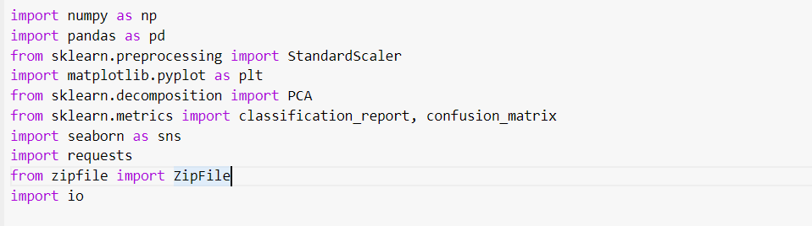
Import Necessary Libraries

Slide 6
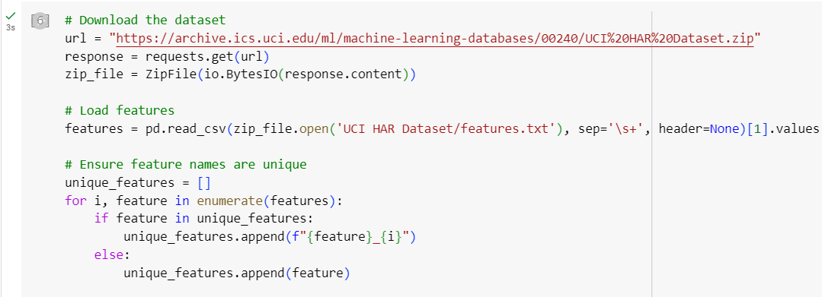
Step 1: Data Loading and Formatting

Slide 7
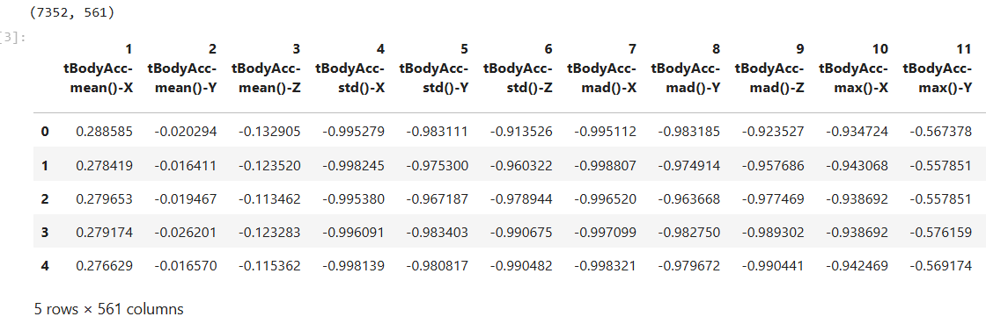
Load Training Data

Slide 8
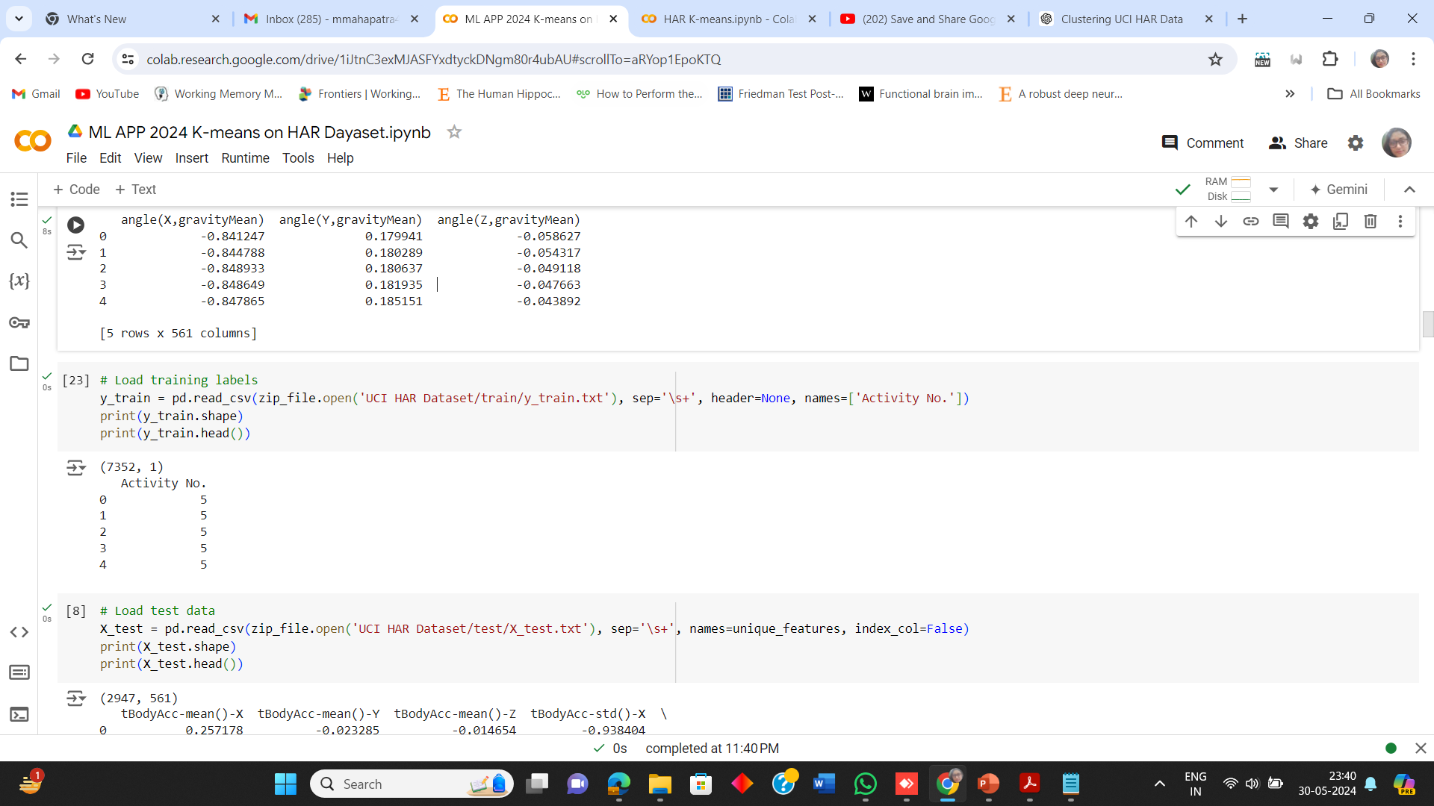
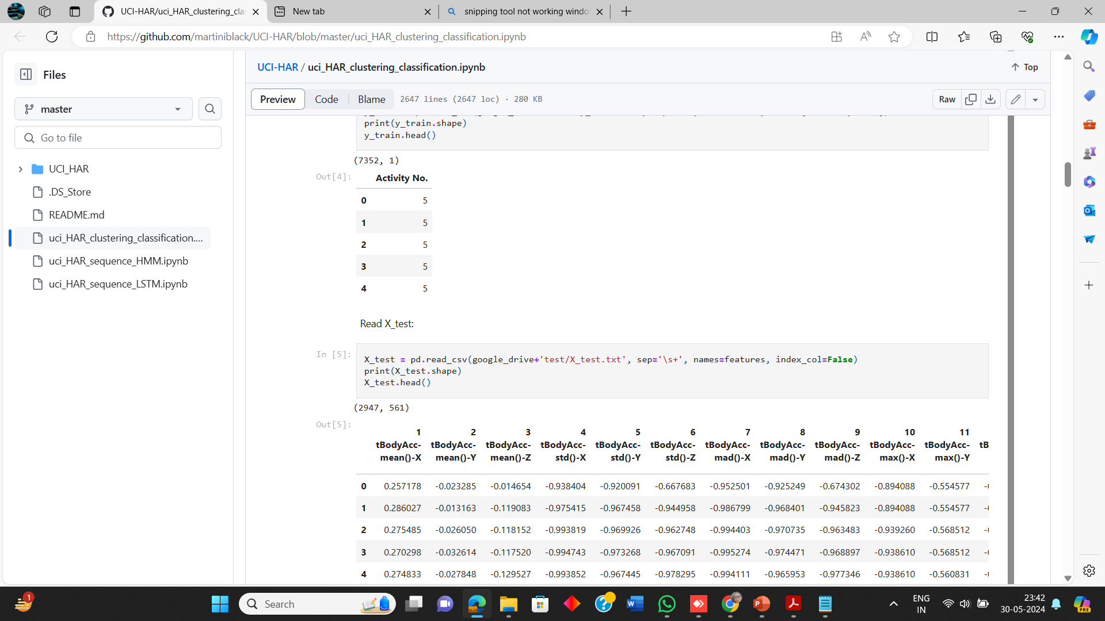
Load Training Labels

Slide 9
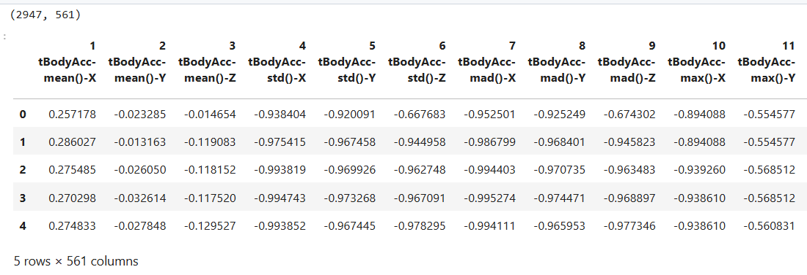
Load Test Data

Slide 10
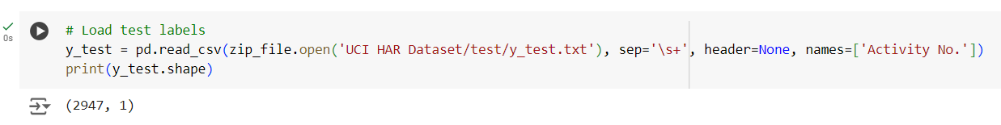
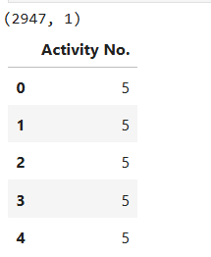
Load Test Labels

Slide 11
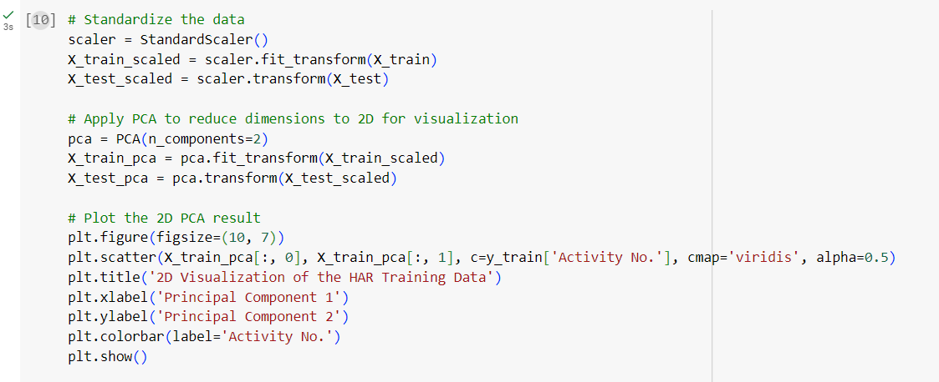
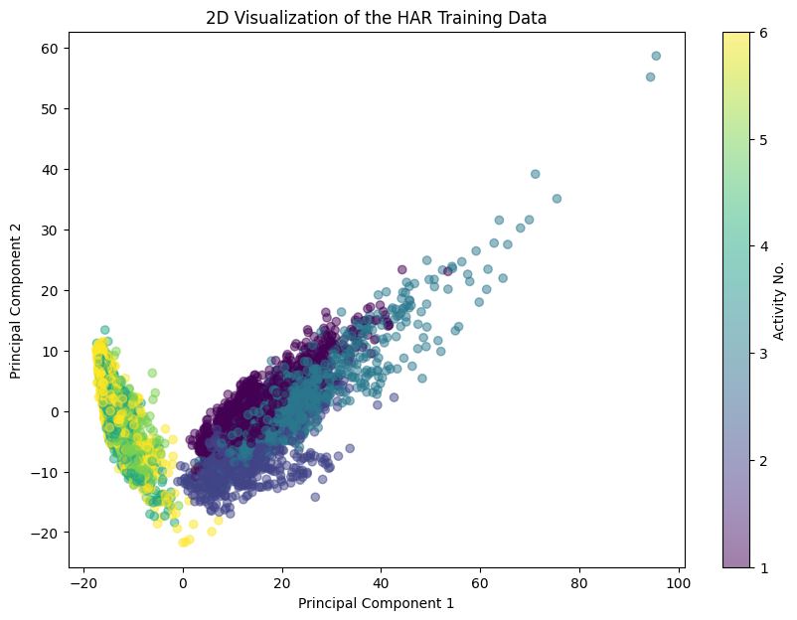
Step 2: Standardize using Z-Score and Apply PCA

Slide 12
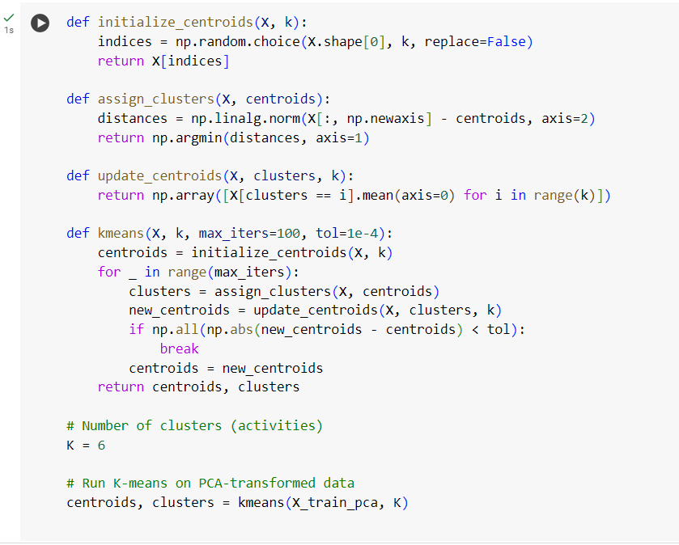
Steps 3 to 6: Run K-means Algorithm

Slide 13
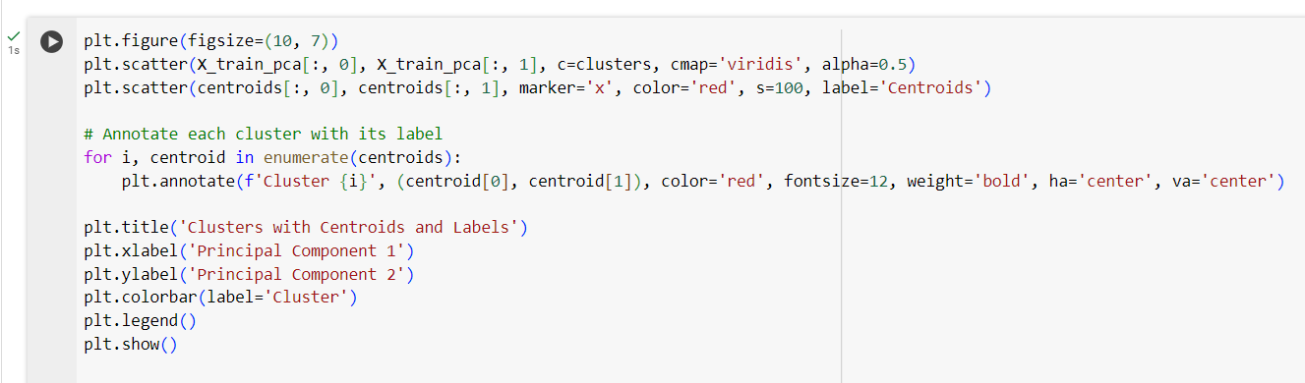
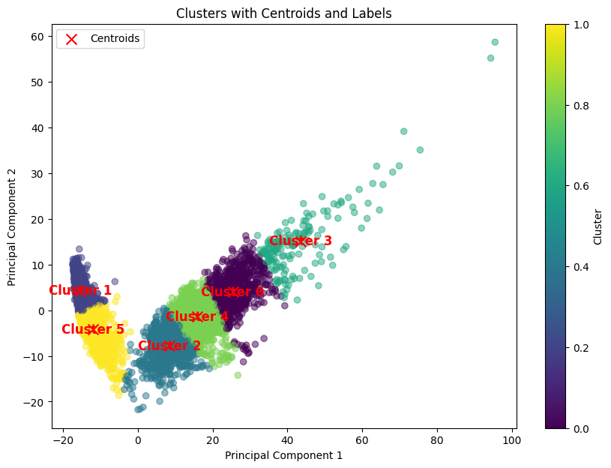
a) Visualize the Clustered Data and Centroids.

Slide 14
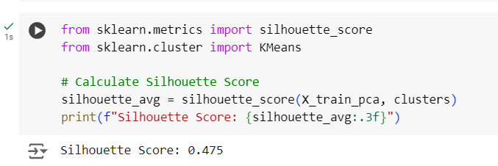
Step 7: b) Calculate the Silhouette Score

Slide 15
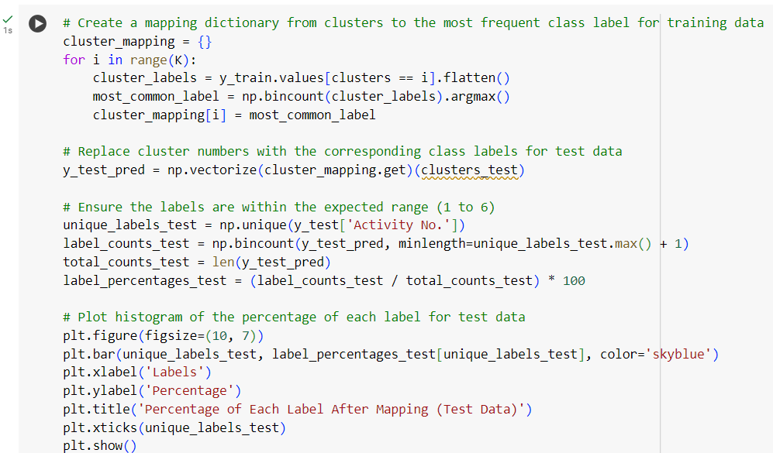
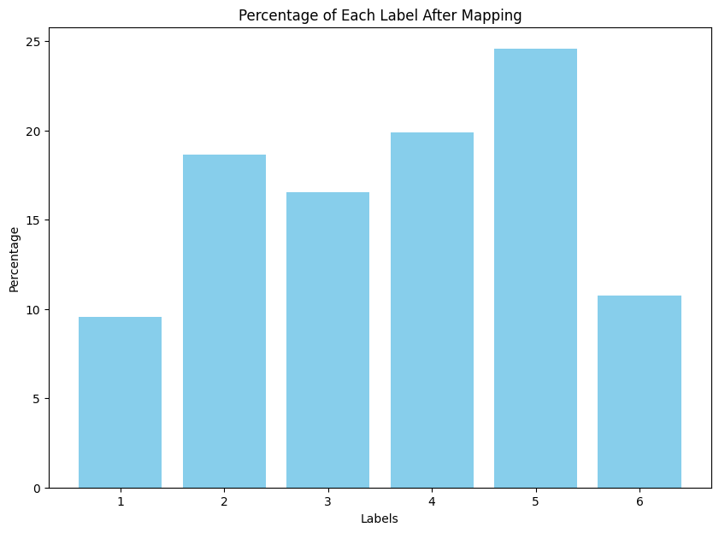
Cluster Mapping with Class Labels

Slide 16
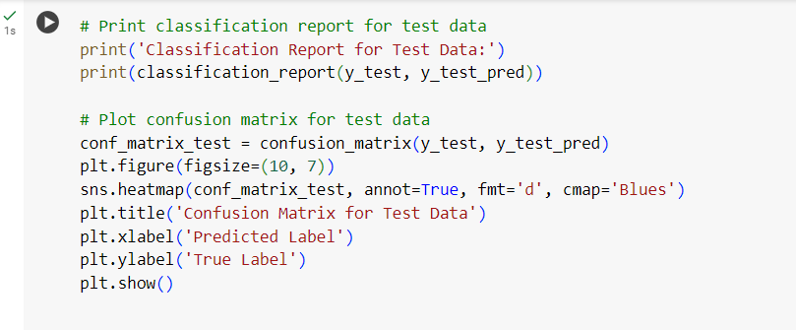
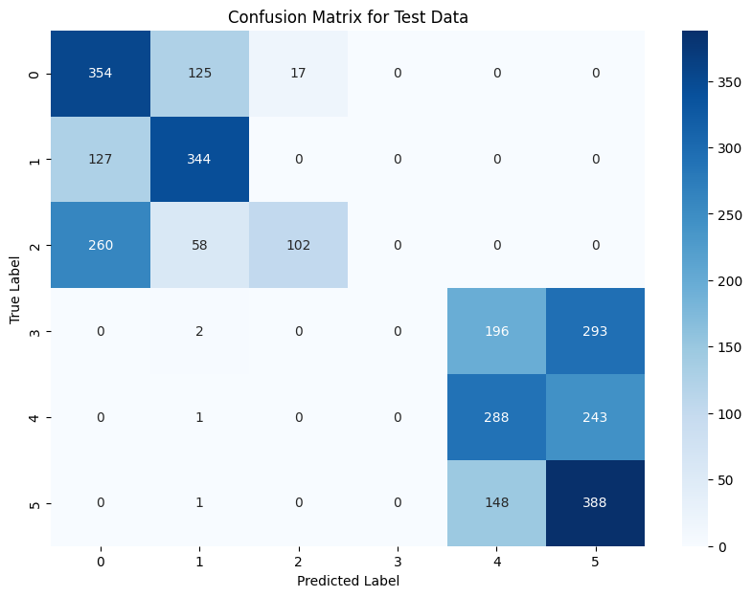
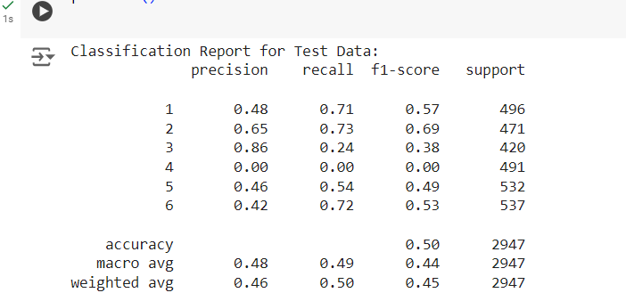
Step 8: c) Generate the Classification Report and Plot Confusion Matrix

